Slide 1
Mapping Services Using Intelligent Routing

Slide 2

Outline
Routing in cloud native apps
Netflix Zuul
Proxy server
Setting up routes
Setting up filters

Slide 3






Individually Deployable Services

Slide 4


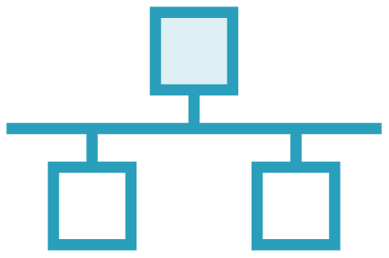
Challenges with Individual Services
IP
Different ports
Different addresses
Different APIs & paths

Slide 5

As a client (such as mobile or web), interacting with each individual service would be a disaster

Slide 6

The Solution: Intelligent Routing
Appears as a whole but still individual pieces

Slide 7
Intelligent Routing via a Gateway Service

Slide 8
API Gateway
… a single entry point for all clients …
- Chris Richardson

Slide 9

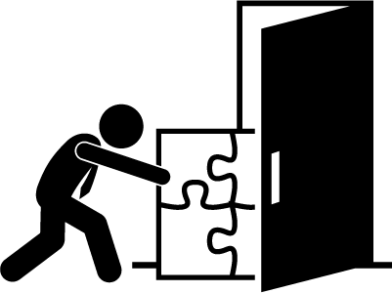
Gateway Service: The Front Door
The front door, edge service, the gateway to services
Services are placed behind the edge service

Slide 10




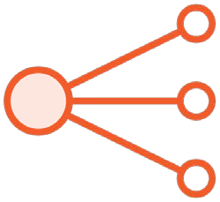


A Gateway Service Provides
Dynamic Routing & Delivery
Security & Filtering
Auditing & Logging
Request Enhancement
Load Balancing
Different APIs for different clients

Slide 11
Intelligent Routing with Spring Cloud & Netflix Zuul

Slide 12
Netflix Zuul
Zuul is a gateway service that provides dynamic routing, monitoring, resiliency, security, and more.
- Netflix Zuul Project Page

Slide 13
Using Spring Cloud & Netflix Zuul
pom.xml
<dependencyManagement>
<dependencies>
<dependency>
<groupId>org.springframework.cloud</groupId>
<artifactId>spring-cloud-dependencies</artifactId>
<version>Camden.SR2</version>
<type>pom</type>
<scope>import</scope>
</dependency>
</dependencies>
</dependencyManagement>

Slide 14
Using Spring Cloud & Netflix Zuul
pom.xml
<dependency>
<groupId>org.springframework.cloud</groupId>
<artifactId>spring-cloud-starter-zuul</artifactId>
</dependency>

Slide 15
Using Spring Cloud & Netflix Zuul Reverse Proxy
Application.java
@SpringBootApplication
@EnableZuulProxy
public class Application {
public static void main(String[] args) { SpringApplication.run(Application.class, args);
}
}

Slide 16

Using Spring Cloud & Netflix Zuul with Service Discovery
application.properties
spring.application.name=gateway-service eureka.client.defaultZone=http://localhost:8761/eureka
OR
application.yml
spring: application:
name: gateway-service eureka:
client:
defaultZone: http://localhost:8761/eureka

Slide 17
Using Spring Cloud &
Netflix Zuul Without Service Discovery
application.properties
spring.application.name=gateway-service ribbon.eureka.enabled=false
OR
application.yml
spring: application:
name: gateway-service ribbon:
eureka: enabled: false

Slide 18
Configuring Routes with Spring Cloud & Netflix Zuul

Slide 19
Default Route to Service Resolution with Service Discovery
Request Service
/foo
Request
/categories/1
sp
ring.application.name=foo
Service
pring.application.name= categories
maps to
s
maps to
* prefix is stripped by default. Use zuul.stripPrefix=false to disable
** All services are added by default. Use zuul.ignoredServices=<pattern> to ignore services

Slide 20
Netflix Zuul with Service Discovery:
Precise Routing
application.properties
spring.application.name=gateway-service zuul.routes.<route_name>.path=/somepath/** zuul.routes.<route_name>.serviceId=some_service_id zuul.ignored-services=some_service_id
application.yml
OR
spring: application:
name: gateway-service zuul:
routes:
<route_name>:
path: /somepath/** serviceId: some_service_id
ignored-services: some_service_id

Slide 21
Netflix Zuul Without Service Discovery:
Precise Routing
application.properties
spring.application.name=gateway-service zuul.routes.<route_name>.path=/somepath/** zuul.routes.<route_name>.url=http://some_url_address/
application.yml
OR
spring: application:
name: gateway-service zuul:
routes:
<route_name>:
path: /somepath/**
url: http://some_url_address/

Slide 22
Creating Filters with Spring Cloud & Netflix Zuul

Slide 23
Filters allow you to intercept and control requests and responses.

Slide 24




Filter Types
|
|
pre
Before the request
post
After the request
route
Direct the request
error
Handle request errors

Slide 25
Creating a Filter: Extend & Implement ZuulFilter
MyFilter.java
public class MyFilter extends ZuulFilter {
// implement methods
...
}

Slide 26
@Override
public Object run() {
}
@Override
public boolean shouldFilter() {
}
@Override
public String filterType() {
}
@Override
public int filterOrder() {
}
⧫ Filter logic goes here. Current implementation ignores return
⧫ Whether or not the run()
method should execute
⧫ The type of filter: pre, route, post, error
⧫ The order of execution with
respect to other filters of the same type

Slide 27
RequestContext ctx = RequestContext.getCurrentContext();
// Get the servlet request HttpServletRequest req = ctx.getRequest();
// Get the servlet response HttpServletResponse res = ctx.getResponse();
// Set a variable
ctx.set("foobar", "PRE_FILTER_EXECUTED");
// Get a variable
String foobar = (String) ctx.get("foobar");
Sharing Between Filters: RequestContext
Holds request, response, state, and data information
Only available for the duration of the request

Slide 28
Creating a Filter: Define an @Bean Which
Returns the Filter
MyConfig.java
@Configuration
public class MyConfig {
@Bean
public ZuulFilter myFilter() { return new MyFilter();
}
}

Slide 29
The need for intelligent routing
Gateway service
Summary
Netflix Zuul
@EnableZuulProxy
Configuring routes
Writing filters

